Slide 1
RFP and SLA
Class 6

Slide 2

Agenda
RFPs
SLAs
IT Governance

Slide 3

Housekeeping
Citations are required. At least two sources. You will lose points if you do not cite your work.
Your memos should be clear & easy to understand.
Get your point across.
Avoid run on sentences.
List pros and cons.
Describe the technology.
Anita does not know IT! You have to convince her.
Recommend and Justify, Justify, Justify!
Keep the amount of quoted material to a minimum please. I’m trying to assess your knowledge of the material, can’t do that when you over quote. Cite the source, restate in your own words.

Slide 4
Memo 5 – Cloud Computing (required memo for ECT424 and IS324)
This must have a Memo format cover page
The memo body recommendation is what applications TRU should consider moving to the cloud (based on your white paper).
I want to know what your opinion is of the types of applications you think it makes sense for retail operations (like TRU) to consider moving to the cloud and why you think so. (examples are ERP, CRM, e-commerce, email, inventory management etc)
The background material will be in the general form of a “white paper.”

Slide 5
Memo 5 – Cloud Computing
On d2l there is a simple template for the white paper (in case you want to use it.)
To construct a White Paper; check out:
https://owl.english.purdue.edu/owl/resource/546/1/

Slide 6
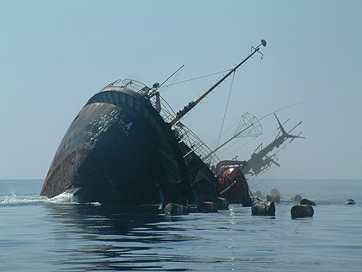
A Possible Problem
Plagiarism
Note that in case I see an increase in the use of material not written by the submitter without proper quotation or citation.
I do, on occasion, use turnitin
This becomes a violation of Academic Integrity Policy and subject to dismissal from the university.
If it happens, I have the right to file an Academic integrity report.

Slide 7
Web Assignment 4
Be sure to follow instructions carefully
Most common error – making only 1 Post for Web 4 – minimum of two are REQUIRED
One can deal with the selection and installation of the theme
One can deal with the selection and installation of the plugins and widgets
When done you will have at least 3 of your posts on your Blog site (context, theme, widgets).

Slide 8
Discussion – Memo 4 – VDI
What did you learn about VDI?
What are the issues being discussed about it?
What part of TRU do you think could benefit from a VDI implementation?
Notes:
1. Every desktop user can utilize the same image.
Pro: Having each user utilize the same image--the operating system as well as the installed applications--reduces administrative and support costs.
Con: You’ll need a unique image for each user who requires a different set of applications
2. Processing moves from individual workstations to a VDI server.
Pro: There’s no need to upgrade numerous PCs to meet the new OS’s minimum hardware requirements.
Con: VDI will require a major investment in server, storage, network. The total cost may be more than of procuring a basic PC for each user.
3. Maintaining a single OS image can reduce management and support costs.
Pro: Install applications, patches, and drivers once, and every user relying on that image benefits from the update.
Con: Administrators will need to learn the VDI software’s capabilities and limitations
4. When you encounter problems, you’ll generally have just one system to troubleshoot.
Pro: Problems can generally be resolved from within the data center; there’s no need to run out to the actual PCs
Con: Server-side problems can affect multiple users--everyone using that server or that image. For that reason, it’s a good idea to set up redundant servers.

Slide 9
And now to tonight’s topics
RFI, RFP,SLA,ITGOV (alphabet soup)

Slide 10
Request for Information (RFI)
Used during Planning Phase
When can’t clearly define product requirements, specification or purchase options
Trying to ID products and services available
Use to collect information about capabilities of suppliers
Be sure that you state a contract will not automatically follow

Slide 11
RFI Best Practices
Use a standardized format (easier comparison)
Be as specific as you can be
Limit the request to information only
Don’t request pricing
Be considerate – this is a relationship building step
Give adequate time to respond

Slide 12
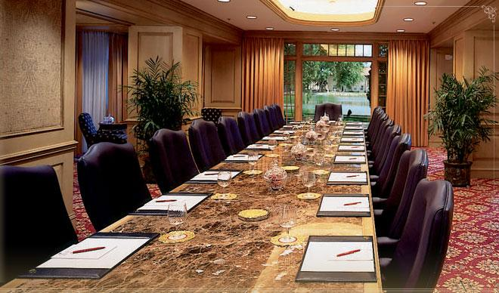
RFPs
Request for Proposals
Harris, G. “Fundamentals of Purchasing”. AMACOM. © 2000
Notes:
Most of the information on RFPs comes from:
Harris, George L.. "Chapter 6 - Develop and Send the Request for Bids or Proposals". Fundamentals of Purchasing. AMACOM. © 2000. Books24x7. <http://common.books24x7.com.ezproxy1.lib.depaul.edu/book/id_14162/book.asp> (accessed January 11, 2010

Slide 13
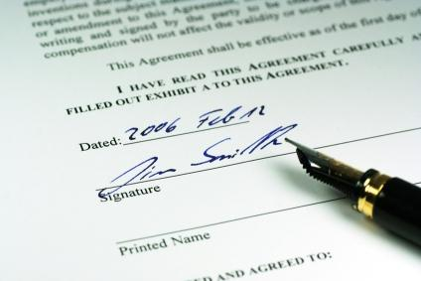
Request for Proposals (RFPs)
What they are
Why they’re needed
How they’re used
Details of interest
An Example
Notes:
Image source: http://bgs.vermont.gov/sites/bgs/files/image/contracts.jpg
Generally speaking we will cover these aspects of RFPs

Slide 14
RFP: Definition
A document that requests bids or proposals from suppliers under specified conditions.
Typically written but can be oral also (not good practice)
Notes:
Usually issued when services being requested
Can be used for product creation/development also

Slide 15
Bid/Quote vs. Proposal
Bid/Quote:
supplier submits a bid or quote when buyer interested in product specifications, price, and delivery terms
Proposal
supplier submits a proposal when buyer is interested in how the supplier will approach the work, the specific tasks to be performed including, schedules, options in pricing, and when the buyer wants to negotiate the terms of the purchase.
Notes:
Many organizations use these terms interchangeably, but it is suggested that the terms be used appropriately.

Slide 16
Comparisons of Bids & Proposals
Bid/Quote
Proposal (more comprehensive)
Products
Specifications
Delivery and Availability
Fixed Prices
Standardized Terms
Off-the-Shelf, Standard Offerings
Prices
Simple Evaluation Criteria
Award on Price
Services
Statements of Work
Tasks and Schedules
Fixed Prices, and Time and Materials or Cost Plus
Standardized and Unique Terms
Custom Offerings
Total Costs
Complex Evaluation Criteria
Award on Price and Other Factors
Notes:
Proposals are more comprehensive

Slide 17
How do you know when to use what?
When it doubt – write it out!
Notes:
One of the basic steps to take when considering the use of solicitations is to determine whether or not the request for a bid or proposal is to be made verbally or in writing, and whether or not the supplier's bid or proposal should be presented orally or in writing.
The circumstances of the purchase and procedures of the Company should be considered when making these decisions.
This matrix tells when to use what
Practice should be to write it out and expect a written proposal

Slide 18
An Example of a Price Quote
Radiology Services from Sunquest
There is a document on D2L for this
(readings section)
Notes:
See file: Rad_Info_Sys_Quote
(This is a Word document)

Slide 19
Written solicitations
Takes many forms including:
e-mail,
fax,
hard copy letter, or some form of verbal communication
Online submission
HAVE DEADLINES!!
Notes:
Deadlines are important. Proposals have been REJECTED because deadlines have been missed, or documents have been delivered to wrong rooms, wrong person!

Slide 20
Business reasons to insist on written solicitations:
Protects both parties' interests
Provides a record of transaction for historical perspective
Ensures that suppliers receive exact information on bid requirements
Efficient use of buyer's resources
Buyer is able to include terms and conditions of purchase and seller can review applicable information.
Notes:
Buyers in organizations that have federal or state customers have more regulatory requirements placed upon them.
Accordingly, they must ensure that terms of their purchase comply with these regulations. Also, they must ensure that suppliers are evaluated according to the evaluation criteria stated in the solicitation.

Slide 21
Features of a Standard Solicitation
Statement of Work/Specifications
Legal Terms and Conditions
Business Conditions
Due Date and Time for Response
Evaluation Criteria (unless Award Is Made Solely on Cost and Availability)

Slide 22
I. Statement of Work/Specifications
Intended to ensure supplier has…
technical ability,
capacity,
experience,
and financial resources
…to perform the work
Notes:
If a supplier does not submit a proposal that addresses all of the key issues of the solicitation, then that proposal can be deemed nonresponsive and may get REJECTED

Slide 23
Buyer should include this type of language:
Supplier must provide data in its proposal regarding Sections ———— of this solicitation. Data includes stating its ability to perform, compliance with contract terms and conditions, and submission of requested plans and standards. Failure to comply with providing this data to buyer may result in buyer's decision, at its sole discretion, to reject the proposal and not consider it further.

Slide 24
Evaulate
Can you understand what is required?
Will a supplier understand what is required?
Will a supplier be able to submit a responsive bid?
Do the requirements unreasonably restrict competition?
Have you received an accurate estimate of the price of the product/service?
Do you agree that the description of the product and service favorably compares to the written estimate?

Slide 25


II. Legal Terms and Conditions
Warranties
Time to repair or replace product or repeat service if work done not performed properly or if workmanship poor
2. Inspection and Acceptance
How product/service to be inspected by buyer and terms of acceptance
Notes:
The length of time that the supplier will repair or replace the product or repeat the service if the work done is not performed properly or has poor workmanship, or materials.
Repair or replacement, as well as warranty responsibilities, should be delineated

Slide 26

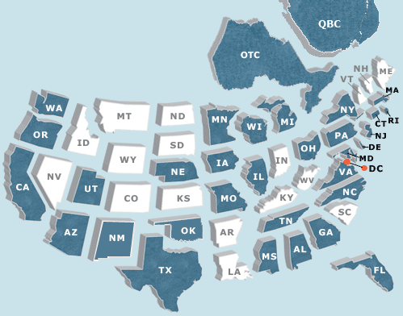
II. Legal Conditions, cont’d
3. Indemnification
Buyer may require supplier to indemnify the buyer against claims arising from suppliers actions or inactions including patent or copyright indemnities
4. Applicable Law
Buyer indicates which state law applies to the purchase
Notes:
Image source: http://blog.blacknight.com/images/euro-dollar-moneybags.jpg
The buyer may be concerned about actions of the supplier that could cause injury to property or persons, or any violation of federal or local laws.
The buyer, in these cases, may require that the supplier indemnify the buyer against any and all claims arising out of supplier's actions or inactions, including patent and copyright indemnities.

Slide 27

II. Legal Conditions, cont’d
5. Disputes and remedies
How these will be resolved and remedies available for seller non-performance
6. Termination
Conditions under which buyer can cancel or terminate agreement
Notes:
This clause describes how disputes will be resolved and what specific remedies are available for seller nonperformance.
One option for dispute resolution is to use the offices of the local American Arbitration Association (AAA), whose decision will be final and nonnegotiable.
Other options include local mediation, self-appointed arbitrators, or local/state court systems.

Slide 28

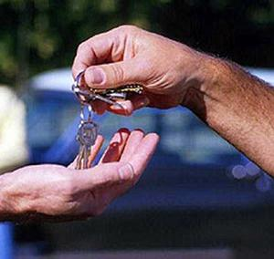
II. More Legal Conditions
7. Changes
Made by the buyer to form, fit or function after contract has been signed
8. Risk Loss
Must define the timing of transfer of title to the product and responsibilities of damage or loss
Notes:
Buyers will make changes to form, fit, or function of the ordered products after the contract has been signed.
Changes in delivery method, quantity, packaging, and lead time may also need to be changed during the course of performance.
The seller will typically be asked to comply with these changes, and submit any impact on price and delivery within a specified period of time, say 30 days, after the changes have been communicated to the supplier.

Slide 29

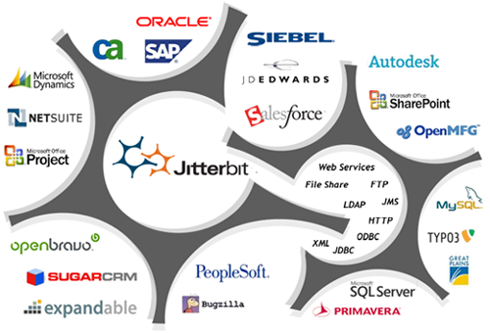
II. Even more Legal Conditions
9. Assignment
Possibility of assigning responsibilities to 3rd party w/o buyer’s consent
10. Integration
Only what’s written in the contract governs the relationship
Notes:
This clause addresses whether the supplier can assign responsibilities to another company without the buyer's consent, the use of subcontractors, and the acquisition of the seller by another company.

Slide 30

II. Legal Conditions
11. Insurance
Buyer usually requires this if work is done at buyer’s site
Notes:
For services, insurance requirements are usually required by the buyer. This is due to the fact that the supplier is performing work at the buyer's site. Insurance provisions in this instance will cover personal, bodily, and property damage. Insurance is required up to a specified amount, at the supplier's cost.

Slide 31


III. Business Conditions
1. Quality requirements
buyer should indicate the overall quality requirements that will be placed on suppliers
2. Inventory
supplier may be asked to hold inventory on the buyer's behalf or consign inventory at buyer's facility
Notes:
The buyer should indicate the overall quality requirements that will be placed on suppliers.
This can be stated in terms of :
zero defects,
100 percent quality performance,
100 percent on time delivery,
perfect documentation, and
100 percent service satisfaction,
including guarantees.

Slide 32


III. Business Conditions, cont’d
3. Payment terms
Addresses the point(s) at which the supplier will be paid
4. Transportation method
Buyer states whether the supplier has the option to use its own transport company,
Notes:
The point at which the supplier will be paid should be addressed, unless the buyer wants the supplier to propose its standard terms, or offer discounts in the event payment is made within a short period, say 10 to 15 days.

Slide 33

III. Business Conditions, cont’d
5. Shipping and Delivery Point
Various shipping points are available including:
Seller's plant
Distribution Facility
Buyer's plant
6. Technical Assistance
Buyer needs in setting up and using products supplied
Notes:
Supplier is responsible for the costs of transport and risk of loss in (a) and (b) above.

Slide 34

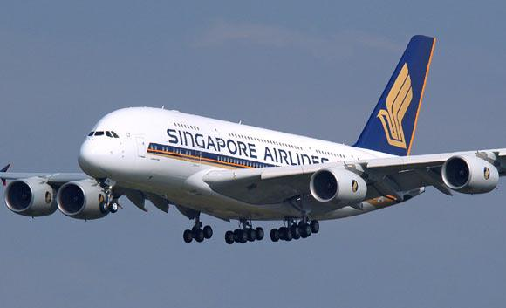
III. Business Conditions, cont’d
7. Installation
Buyer will likely ask supplier to ensure product installed properly
8. Delivery Schedule
Specific delivery schedule and quantities of products or services
Notes:
For capital equipment, the buyer will most likely ask the supplier to ensure that the product is installed appropriately and in the most effective condition in order for the buyer to receive maximum benefit from the equipment.
Installation can occur at buyer's site, at an end user's site, or at a third-party's site.

Slide 35


III. Business Conditions, cont’d
9. Packaging
Strength, material composition, inside and outside packaging
10. Type of Contract
Selected by buyer dependent on specification of the work and ability of supplier to develop accurate proposal
Notes:
The buyer may state the markings required to be placed on shipped materials, and/or specify the packaging requirements in terms of strength, material composition, and both inside and outside packaging. These materials may be specifically called out, provide for seller's decision making or preferences in this area, or allow for reusable or returnable packaging.

Slide 36
IV. Due Date and Time for Response
Proposal Development Time
Complexity of requirement
Length of agreement
Standard versus custom needs
Partnership or arms-length relationship desired
Purchase order or contract terms
Proposal submittal requirements
Local or worldwide bid
Notes:
Some bids or proposals can be prepared in two to three days and be returned by e-mail, fax, or overnight mail. In other instances, suppliers may need over two weeks to respond.
Careful consideration should be given to bid time because rushed proposals may cause suppliers to inadequately address your technical or business requirements, or the supplier may simply add costs to their bid/proposal to offset the lack of time.

Slide 37
V. Evaluation Criteria
Two basic options:
Proposals can be evaluated based on purchase price and availability of product/service; or
Proposals can be evaluated using a number of factors, including price. This system includes weighting of criteria and measuring/rating proposals against meeting the criteria.
Notes:
The evaluation criteria for situation 2 must be fully described in the solicitation so suppliers can meet requirements by submitting proposals that include specific approaches and plans.
Records of Past Performance
The buyer will typically ask the supplier for records of past performance, or request that they provide samples of products so that the buyer can assess their ability to satisfy the buyer's requirements. There are a number of options available for consideration as part of the solicitation:
Ask for references—remember that suppliers will only give you favorable references.
Ask for a current customer list—this is more satisfactory as you can then choose which references to use.
Request samples from the supplier so that they can be evaluated for compliance.
Research the current experience with suppliers, and perhaps current bidders, in terms of delivery and quality performance.
Ask suppliers to provide data on feedback they have received from their customers on current performance.

Slide 38
V. Evaluation Criteria, cont’d
Records of Past Performance
Ask for references
Ask for a current customer list
Request samples from the supplier so that they can be evaluated
Research the current experience with suppliers, and perhaps current bidders, in terms of delivery and quality performance
Ask performance to provide data of feedback received from other customers
Notes:
The buyer will typically ask the supplier for records of past performance, or request that they provide samples of products so that the buyer can assess their ability to satisfy the buyer's requirements.

Slide 39
V. Evaluation criteria, cont’d
Other special conditions
Buyer approvals
Security
Non-disclosure of proprietary information
Level of effort (hours)
Requirement for reports
Software source code
Bankruptcy rights
On-site presence
Notes:
Each of these and other "special" conditions should be accurately described so that the supplier can receive a full picture of the buyer's requirements.

Slide 40
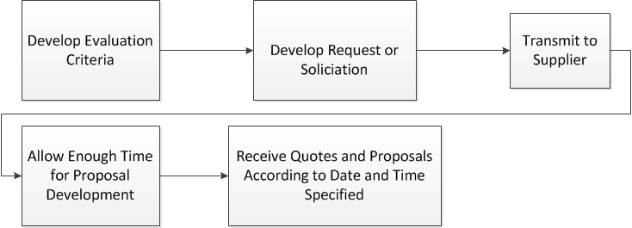
Process

Slide 41
Best Practices: Writing Solicitations
Be
Concise
Consistent
Considerate of time
Accurate
Thorough
Notes:
When requesting bids or proposals from suppliers, the solicitation should be written in a clear and concise manner, taking the simplest form of product/ service description as well as comparable form of business and legal conditions.
Suppliers should be advised of the bid requirements prior to receiving the solicitation, and they should be briefed on proposal information.
Submittals should be kept at a minimum, and the standards for bid comparison should be consistently applied to all bidders.
The product or service descriptions should be specific so they can be understood by all potential bidders.
Also, take the view of the supplier. Ensure that any competent supplier could submit a responsive bid or proposal. This will make you successful!

Slide 42

RFP Example/Template
City of Bellevue, Washington for Miscellaneous IT Services
RFP template example (in word)
Posted on D2L (readings section)
Notes:
PDF file source: http://www.mrsc.org/RFPs/rfps.aspx
See PDF file

Slide 43

SLAs
Service Level Agreements
Hiles, Andrew. E-Business Service Level Agreements: Strategies for Service Providers, E-Commerce and Outsourcing. Rothstein Associates. © 2002
Notes:
Most material taken from Source: Hiles, Andrew. "Chapter 1 - The E-Business Context". E-Business Service Level Agreements: Strategies for Service Providers, E-Commerce and Outsourcing. Rothstein Associates. © 2002. Books24x7. <http://common.books24x7.com.ezproxy1.lib.depaul.edu/book/id_3570/book.asp> (accessed January 11, 2010)

Slide 44
SLAs
What they are
Why they’re needed
How they’re used
Details of interest
An Example

Slide 45
Internal vs External
SLA are not just external (with your providers)
Growing use internally (why?)
Keeps IT honest
Helps them ensure they are providing services their customers want and value
Provides measures of success

Slide 46


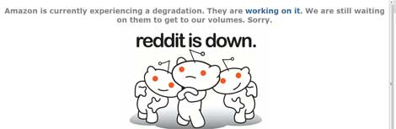
Impacts
Company | Date | Duration of Outage | Losses, Costs
AT&T | Feb 1998 | 6-26 hours | Rebates of $40m
Charles /Schwab | Feb-Apr 1999 | 6 – 26 hours | Losses believed to be hours >$20m; $70m invested in infrastructure
E-Bay | June 1999 | 22 hours | $3 – $5m; Shares: down 26%
E*Trade | February – March, 1999 | >5 hours | Revenues: $3m $Shares: down 22%
Amazon | April 2011 | >13 hours | Were there losses?!
Notes:
Source: Comdisco
There have been some spectacular losses following e-business outages. The biggest hit is not necessarily the loss of income or profit, but the impact on stock values, especially when the markets are skittish.
The difficulty is that any prospective customer sees only their end supplier as to blame for loss of service, no matter how many intermediate suppliers there were. It's the reputation and profitability of the end supplier that is at stake and they need the protection of SLAs to focus the suppliers that support them.
Amazon’s SLA for EC2 is 99.95% for multi-AZ deployments (defines unavailability as a lack of external connectivity to EC2 instances,)- their problem was with the elastic block storage (EBS) and Relational Database Service (RDS) – neither of which is under an SLA so technically, they didn’t violate their SLA.

Slide 47
Loss impact
In 2014 EMC Corporation surveyed 3,300 IT decision makers from across 24 countries in an effort to determine how well organizations are prepared to deal with incidents resulting in downtime and data loss.
According to the study, enterprises (organizations employing more than 250 people) have lost a total of $1.7 trillion!! in the past year due to downtime and data loss.
While the overall number of data loss incidents has decreased, the volume of lost data has increased by 400% over the last two years.

Slide 48
Definition
A Service Level Agreement (SLA) is an agreement between the provider of the computing service and the customers of it….
quantifying the minimum acceptable service to the user.
Notes:
A failure of a critical application can lead to a few types of losses:
Loss of the application service – the impact of downtime varies with the application and the business.
Loss of data – the potential loss of data due to a system outage can have significant legal and financial impact.

Slide 49

Why “an agreement”?
negotiation and commitment from both service provider and customer.
Notes:
The service quality has to be objectively quantified so that achievement or non-achievement of it can be monitored. It is the minimum quality since excess quality costs money. That quality has to be acceptable to the customer (i.e. it has to meet the customer's minimum business need).
The SLA requires a clear definition of service boundaries and service responsibilities from the service supplier. Service can only be managed by formally defining not only supplier responsibilities but also customer responsibilities in terms of input accuracy, throughput, estimated forecast of volumes and in meeting their relevant deadlines.

Slide 50
SLA should cover the following:
Purpose of SLA
Duration of agreement
Description of application or service
Service overview
Any corporate dependence
Priority
Impact and cost of outage

Slide 51
SLAs should cover: (2)
Traffic volumes
standard day
critical periods
peak periods
Forecast utilization and growth/decline
now
projected growth or decline in 6 months
projected growth or decline in 1 year and as far forward as is practicable

Slide 52
SLAs should cover: (3)
Cache / storage requirements
physical access control
logical (systems) access control
back-up
disaster recovery and contingency planning
Any Value Added / Managed Services

Slide 53
SLAs should cover: (4)
Service levels (e.g. availability, reliability, response, latency with definitions)
Scheduled downtime (if any)
Support hours
help desk
technical support
customer account management arrangements

Slide 54
SLA should cover: (5)
Problem escalation procedure
Technical
Managerial
Charging arrangements
Change control
Service level measurement
Customer Satisfaction
Monitoring actual service level against SLA targets
Service level reporting
Penalties for failure
Arbitration and mediation arrangements
Arrangements for customer/supplier review meetings
Contacts (inside and outside normal working hours)
Duration of agreement
Review / renegotiation arrangements

Slide 55

Service Quality (in SLA)
Times
Service Availability
Service Reliability
Delay, response, latency, lead time
Notes:
The times at which specified service functions and facilities are available to specified service users and at specified points of service consumption. Also the overall availability as a percentage of scheduled availability. These times will be achieved to at least defined levels
Availability of the service, where the actual service availability is usually expressed as a percentage of the scheduled availability of the service
The reliability of service (i.e. how many interruptions of service were experienced over a defined period)
The delay, response, latency or lead-time achieved to defined levels.
Application Service Providers (and in-company services delivering internet, intranet and extranet delivery for applications) should also address the issue of application brownouts in their Service Level Agreements. Brownouts can be highly disruptive and seriously damage productivity of end users.
Brownouts (drop in voltage in an electrical power supply; incomplete blackout) are not only damaging and potentially expensive, but are also difficult to detect.
The agreed service quality is that which can only be achieved if the service functions and facilities are used within any volume, time and other constraints defined. Where these constraints are exceeded the service quality is expected to be below the agreed service levels.

Slide 56

A concept: Uptime/Availability
The proportion of the time or when the function and facilities provided are actually available as a % of scheduled.
Could be expressed as actual times or as:
24/365
from xx.xx hours to xx.xx hours on specified days
at xx.xx hours on specified days
http://www.internettrafficreport.com/details.htm
Notes:
The proportion of the time or when the function and facilities provided are actually available expressed as a percentage of the amount of time when they are scheduled to be available. Availability is typically expressed as a percentage of scheduled availability although it could be expressed as actual times or as:
24/365
from xx.xx hours to xx.xx hours on specified days
at xx.xx hours on specified days

Slide 57
What does it mean in real time?
Up Time % (over 365 days) | Down Percent | # days | #hours
98.5 | 1.5 | 5 | 120
99 | 1 | 3.65 | 87.6
99.5 | 0.5 | 1.825 | 43.8
99.75 | 0.25 | 1 | 22
99.9 | 0.1 | .365 | 9.75
99.95 | 0.05 | .1825 | 4.38
99.99 | 0.01 | .0365 | 1 hour
99.99% uptime over a 30 day month is 4.32 min of down time

Slide 58
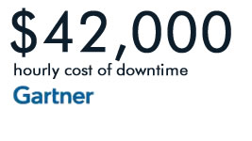

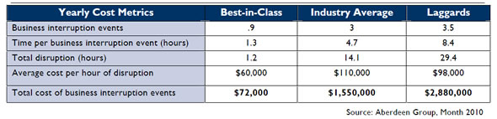
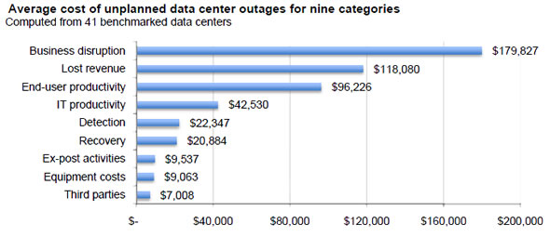
Notes:
The average cost of data center downtime across industries was approximately $5,600 per minute. (Unplanned IT Outages Cost More than $5,000 per Minute).

Slide 59

Other concepts: Delay
Delay or Response is the elapsed time for a packet to be passed from the sender, through the network, to the receiver.
Increased delay is characterized by lack of response of the application or system.
Typically host and database processing time is excluded from response measurement

Slide 60
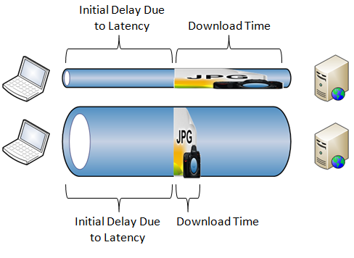
Other concepts: latency
An aspect of response or delay.
Latency is the amount of time it takes to transmit a single piece of data from one location to another.
In one SLA it was defined as: The Network Transit Time for a 128-character-length package (a "Packet") — i.e., a single trip.
But it is more usually expressed
as round-trip delay

Slide 61
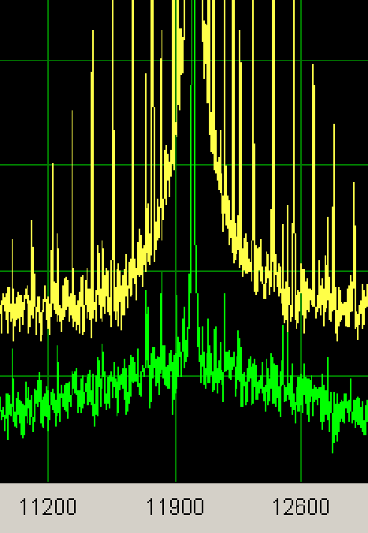
Other concepts: Jitter
Jitter is the variation in end-to-end transit delay.
High jitter is not tolerable in some real-time activities such as audio or video transmissions, where it creates distorted reception.

Slide 62
Jitter explained

Slide 63
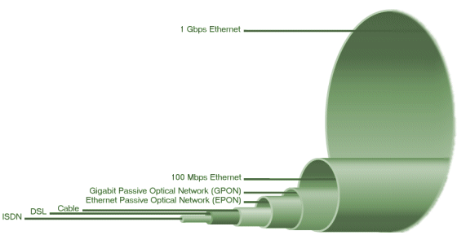
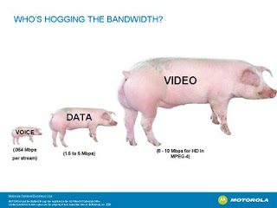
Other concepts: Bandwidth
Bandwidth is the maximum data transfer rate that can be sustained between two end points.
Bandwidth limitations arise from constraints within the network infrastructure and the traffic on it.

Slide 64
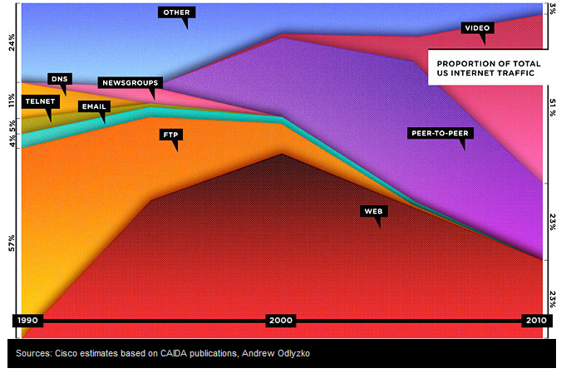
Other concepts: Reliability
Reliability is normally defined as packet loss.
It may also apply to packets delivered in the wrong order. In audio and video transmissions, packet loss is identified by the sound or picture breaking up or moving jerkily.

Slide 65
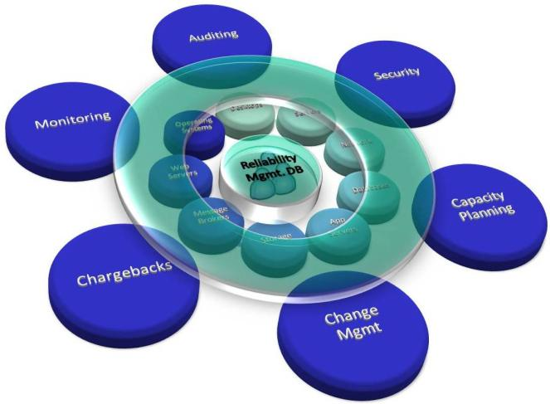
More on Reliability
Also defined as the number of unscheduled outages of service
preferable to have as few outages as possible
in some cases it might be better not to suffer a single long outage but to have more, but shorter, outages
Notes:
With traditional IT applications, it is usually preferable to have as few outages as possible. However, for internet based services this is not necessarily so: in some cases it might be better not to suffer a single long outage but to have more, but shorter, outages. In either event, a SLA might therefore define a maximum number of outages and the maximum acceptable duration of each outage.

Slide 66
Feature: E-Commerce & SLAs
Application | $000s/hour
Brokerage Operations | $6,000
Credit Card Authorization | $2,500
Pay-per-view | $145
Home Shopping | $110
Catalog Sales | $110
Airline reservations | $100
Teleticket sales | $70
Package shipping | $25
Source: Contingency Planning Research & Dataquest

Slide 67

E-Commerce SLAs Should Consider:
High volume/value: potential loss justifies service level
Apply SLA definition to your situation
Establish what to include
Keep all service aspects together in an SLA appendix
Ensure measurements meaningful
Notes:
*SP based services can be high volume and / or high value: the potential for loss justifies the service level
Apply the definition of SLAs to your own situation: some will be much more legalistic and contractual than others
Establish what you are going to include in the SLA, and what in a contract
If the SLA is part of a contract, keep all the service aspects together in a single SLA Appendix — do not mix them up within the commercial and legal aspects of the contract
Ensure that service measurements are meaningful and relate to the end customer or end user's actual experience — beware averages over extended time periods

Slide 68

More Considerations
“Close down” percentages
Decide on the basis on which penalties will be set
Legal jurisdiction
Residual risk
Plan for change
Notes:
Where percentages are used, wherever possible close them down — (e.g. 95% of requests will be completed within x hours, 100 percent within y hours).
Decide on the basis on which penalty payments will be set and identify how such payments can be upheld by law
Establish the legal jurisdiction
Consider the residual risk (e.g. is it insurable). Residual risk is the portion of the risk that is left after a risk assessment has been conducted.
Plan for change — consider scalability issues.

Slide 69
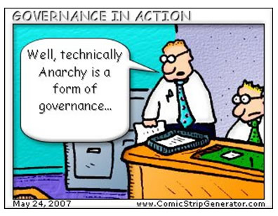
IT Governance

Slide 70

What is IT Governance?
“Specifying the decision rights and accountability framework to encourage desirable behavior in using IT.”
Weill & Ross, (2004) IT Governance, HBS Press.
or
IT Governance is putting structure around how organizations align IT strategy with business strategy, ensuring that companies stay on track to achieve their strategies and goals, and implementing good ways to measure IT’s performance.
Karen D. Schwartz CIO Magazine (2007)

Slide 71
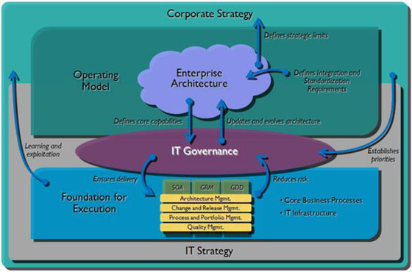
Role of IT Governance

Slide 72

IT Governance Framework
An IT governance framework consists, essentially, of a set of principles, a decision-making hierarchy and a tailor-made suite of reporting and monitoring processes.

Slide 73
Why have IT Governance?
Survey by MIT/Slone of 250 organizations and how they govern IT.
“We conclude that effective IT governance is the single most important predictor of the value an organization generates from IT.”
Weill & Ross, (2004) IT Governance, HBS Press.

Slide 74
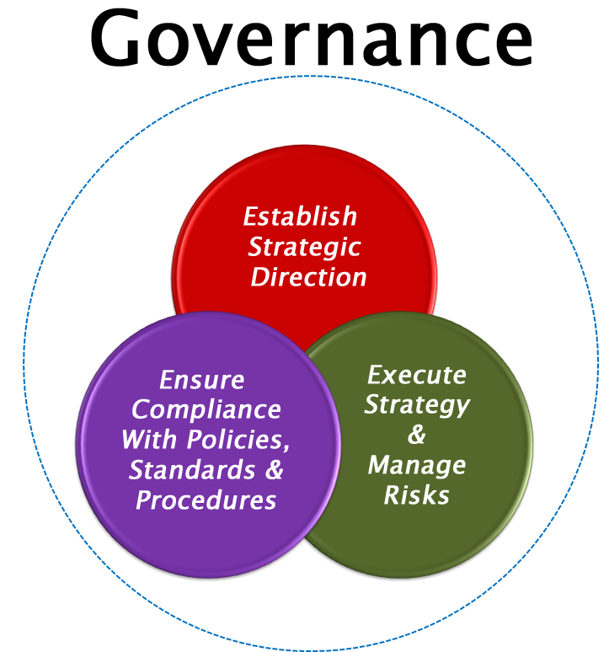

Slide 75
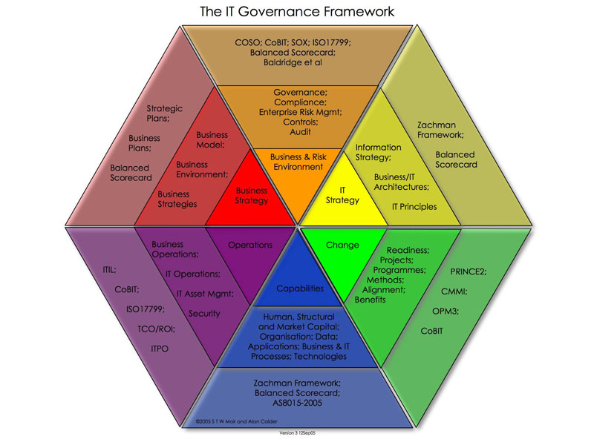
Calder-Moir IT Govern. Framework
ISO/IEC 38500
CoBIT
ITIL
ValIT
Notes:
ISO/IEC 38500 is an international standard for Corporate governance of information technology published jointly by the International Organization for Standardization (ISO) and the International Electrotechnical Commission (IEC). It provides a framework for effective governance of IT to assist those at the highest level of organizations to understand and fulfill their legal, regulatory, and ethical obligations in respect of their organizations’ use of IT.
ISO/IEC 38500 is applicable to organizations of all sizes, including public and private companies, government entities, and not-for-profit organizations.
It sets out six principles for good corporate governance of IT:
Responsibility, Strategy, Acquisition, Performance, Conformance and Human behavior
COBIT is a framework for developing, implementing, monitoring and improving IT governance and management practices.
The COBIT framework is published by the IT Governance Institute and the Information Systems Audit and Control Association (ISACA)
COBIT is based on five key principles for governance and management of enterprise IT:
Principle 1: Meeting Stakeholder Needs
Principle 2: Covering the Enterprise End-to-End
Principle 3: Applying a Single, Integrated Framework
Principle 4: Enabling a Holistic Approach
Principle 5: Separating Governance From Management

Slide 76
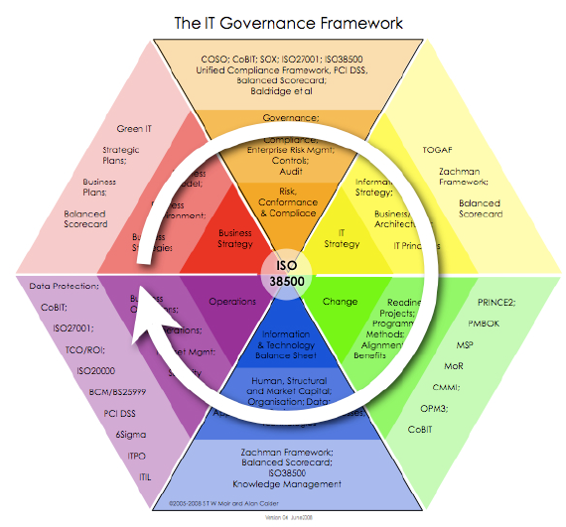
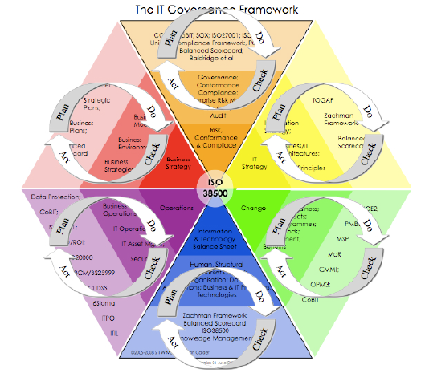
Plan
Plan
Do
Do

Slide 77
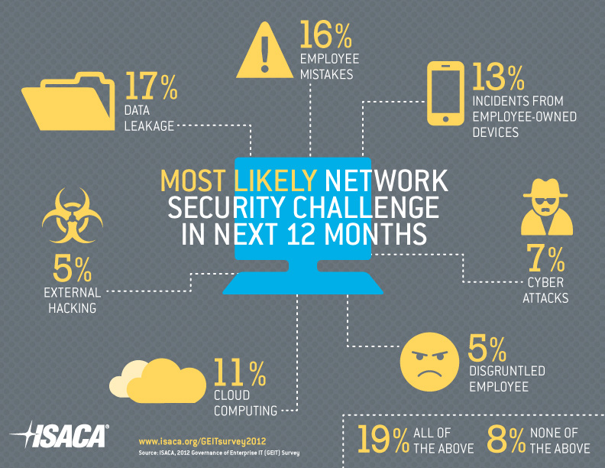
Information Systems Audit and Control Association
Professional association focused on IT Governance
Notes:
Nearly a quarter of respondents said management’s level of involvement in governance is low
22 percent of organizations have experienced a security breach in the last 12 months
52 percent say they don’t have enough IT staff
47 percent of enterprises have incurred an unexpected cost due to an IT-related problem or incident in the last year
Data leakage is among the top hot-button security challenges facing enterprises in the next 12 months
49 percent of enterprises will be increasing investments in IT over the next 12 months
More than half of responding enterprises use a governance framework.

Slide 78
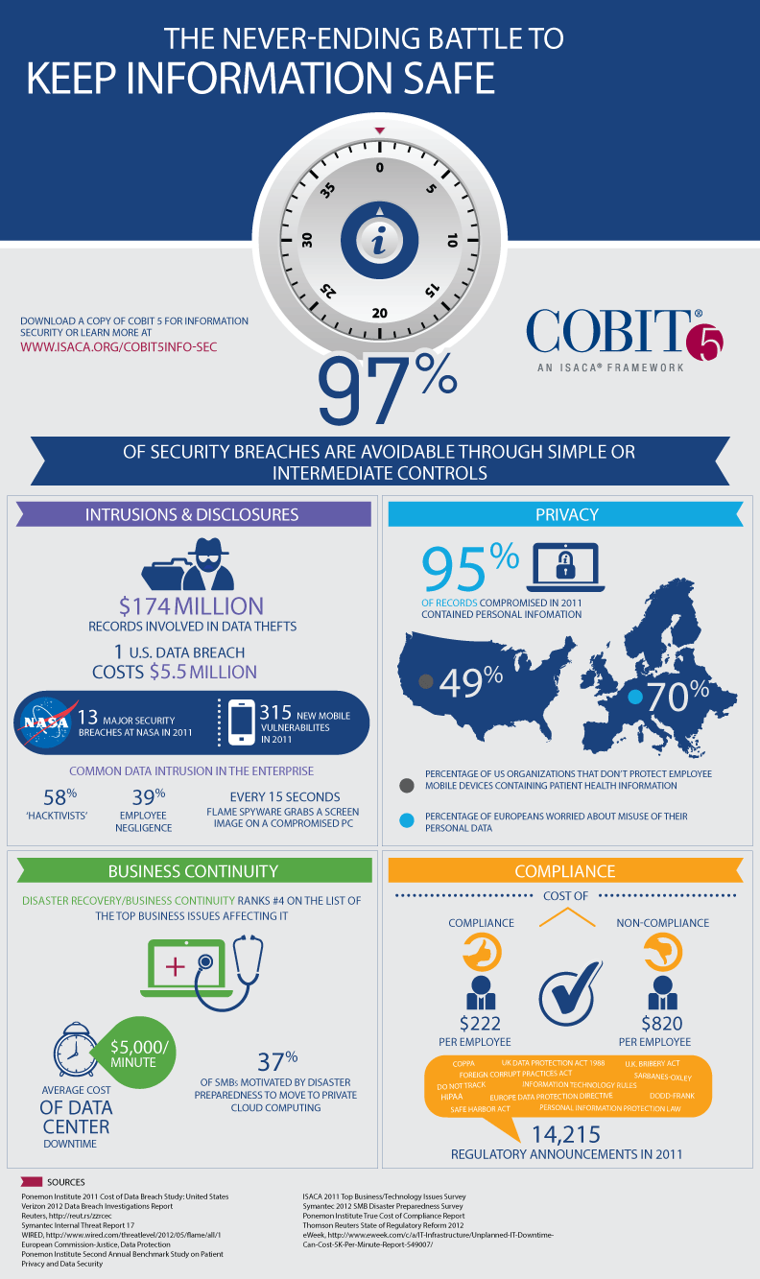
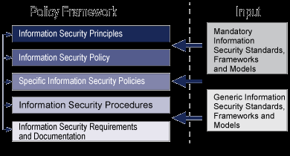
COBIT 5 is an ISACA framework
You can download COBIT 5 framework here: (it will cost you!)
http://www.isaca.org/COBIT5INFO-SEC
It defines the Security Policy framework

Slide 79
8 Key Decision Areas
Governance Principles and decision-making hierarchy
Information Strategy
Risk Management
Software applications
ICT Architecture
ICT Infrastructure/technology
Investment and Project Governance
Information Compliance and Security

Slide 80
1. Governance Principles/Decision-Making
There are two types of principle in this context:
governance principles
How IT is to be managed in the enterprise
implementation principles
How IT is to be used to achieve the business strategy.

Slide 81
1. Decisions
Three governance questions...
What decisions must be made?
Who should make these decisions?
Input rights
Decision rights
How will we make and monitor these decisions?
5 types of Decisions….6 Archetypes…
Weill & Ross, (2004) IT Governance, HBS Press.

Slide 82
What decisions must be made?
IT Principles Decisions
High-level statements about how IT is used in the business
IT Architecture Decisions
Organizing logic for data,
Applications, and infrastructure
captured in a set of policies,
relationships and technical
choices to achieve desired
business and technical
standardization and integration.
IT Infrastructure
Decisions
Centrally coordinated, shared IT
services that provide the foundation
for the enterprise IT capability.
IT Investment and Prioritization Decisions
Decisions about how much and where to invest in IT, including project approvals and justification techniques
Business application needs
Specifying the business need
for purchased or internally developed
IT applications.
Weill & Ross, (2004) IT Governance, HBS Press.

Slide 83
Questions Key to each IT Decision
IT Principles
What is the enterprise’s operating model?
What is the role of IT in the business?
What are IT-desirable behaviors?
How will IT be funded?

Slide 84
2. Information Strategy
(which MUST be derived from the business strategy):
What information do we need, where does it come from and what are we going to do with it?
Out of the information strategy comes the ICT strategy, which is made up of:
application,
architecture, and
infrastructure/technology strategies.
Notes:
ICT- information and communication technology

Slide 85
3. IT Risk Management
Within the context of the organization’s overall risk management framework,
risk to information and ICT
Assessing the severity

Slide 86
Risk Severity Assessment
Tag | Meaning | Definition
SEV1 | Critical | A revenue-generating opportunity, or representing a definite and substantial financial, legal or HR risk to the business. For software development, this represents functionality that is unavailable, severely corrupted, or severely degraded for a significant number of customers and/or employees.
SEV2 | Serious | A cost-containment opportunity, or representing a moderate financial, legal or HR risk to the business. In software development, this represents functionality that is unavailable, severely corrupted, or severely degraded for a limited number of customers and/or employees.
SEV3 | Medium | A potential legal, HR or financial risk to the business. In software development, this represents an issue where a bypass or manual fix is available.
SEV4 | Minor | No potential cost savings or revenue generating capability, and no risks to the business. In software development, this represents functionality that is degraded, but this degradation is relatively insignificant (i.e. cosmetic or negative goodwill).

Slide 87
4,5,6. Software, ICT Architecture and ICT Technology
How applications are specified, developed, authorized, acquired and managed
Integration, standardization of ICT architecture
Infrastructure
How are IT services specified, developed, authorized
What services should be outsourced, how, why and by whom

Slide 88
Questions Key to Each IT Decision
4. Business Application Needs
What are the market and business process opportunities for new business applications?
How are experiments designed to assess whether they are successful?
How can business needs be addressed within architectural standards? When does a business need justify an exception to standards?

Slide 89
Questions Key to each IT Decision
5. IT Architecture
What are the core business processes of the enterprise? How are they related?
What information drives these core processes? How must the data be integrated
What technical capabilities should be standardized enterprise-wide to support IT efficiencies and facilitate process standardization and integration?
What activities must be standardized enterprise-wide to support data integration?
What technology choices will guide the enterprise’s approach to IT initiatives?

Slide 90
Questions Key to Each IT Decision
6. IT Infrastructure
What infrastructure services are most critical to achieving the enterprise’s strategic objectives?
For each capability cluster, what infrastructure services should be implemented enterprise-wide and what are the service-level requirements of those services?
How should infrastructure services be priced?
What infrastructure services should be outsourced?

Slide 91

7. IT Investment
Which initiative should be implemented
Prioritization
Managed (as a project)
ROI

Slide 92
Questions Key to Each IT Decision
7. IT Investment and Prioritization
What process changes or enhancements are strategically most important to the enterprise?
What are the distributions in the current and proposed IT portfolios?
Are these portfolios consistent with the enterprise's strategic objectives?
What is the relative importance of enterprise-wide versus business unit investments?
Do actual investment practices reflect their relative importance?

Slide 93

8.Compliance and Security
Criteria for securing information
Demonstration of legal/regulatory compliance
Measurements?
IP protections
Audits

Slide 94
Who Makes the Decisions
Governance Archetypes
Business Monarchy
Group of business executives (may include CIO)
IT Monarchy
IT Executives
Feudal
Business Unit Leaders, Process Owners
Federal
C-Level executives and business units (central and state government)
IT Duopoly
IT executives and one other group
Anarchy
Each individual user

Slide 95
IT Governance Components
Governance Decisions
Domain
Style
IT Principles
IT Architecture
IT Infra- structure
Strategies
Business
Application Needs
IT Investment
Business
Monarchy
IT
Monarchy
Feudal
Governance Archetype
Federal
Duopoly
Anarchy
Don’t Know
© MIT Sloan CISR
Notes:
Figure 2-7 Which Governance Style for each Key IT Decision
What are the components of top level IT governance?
A matrix can be used to depict governance arrangements by listing the six governance styles on the vertical and map them to the five IT domains on the horizontal.
The MIT Sloan CIST and Gartner EXP study identified how 250 enterprises made major decisions - who had decision rights and who had input about each of the five IT domains.
Evidence to date shows that there are typical IT governance input and decision rights patterns. The federal style dominates, with IT making infrastructure and architecture decisions
Source: MIT Sloan CISR

Slide 96
IT Duopoly
IT Executives and one other group
2-party arrangement where decisions represent a bilateral agreement
Differs from a federal model in that federal always has both corporate and local business representation
Duopoly has one or the other – but not both – and always includes IT professionals
Duopolies can take one of two forms
Bicycle wheel or t-shaped
Weill & Ross, (2004) IT Governance, HBS Press.

Slide 97
Bicycle Wheel IT Duopoly
BU
BU
RM
RM
IT
BU = Business Unit
RM = Relationship Mgr
RM
RM
BU
BU
Weill & Ross, (2004) IT Governance, HBS Press.

Slide 98
T-Shaped IT Duopoly
Executive Committee
X X X X X X Y X X X X X X
Y
Y
Y
Y
Y
Y
IT Committee
X = Business manager
Y = IT manager
Weill & Ross, (2004) IT Governance, HBS Press.

Slide 99
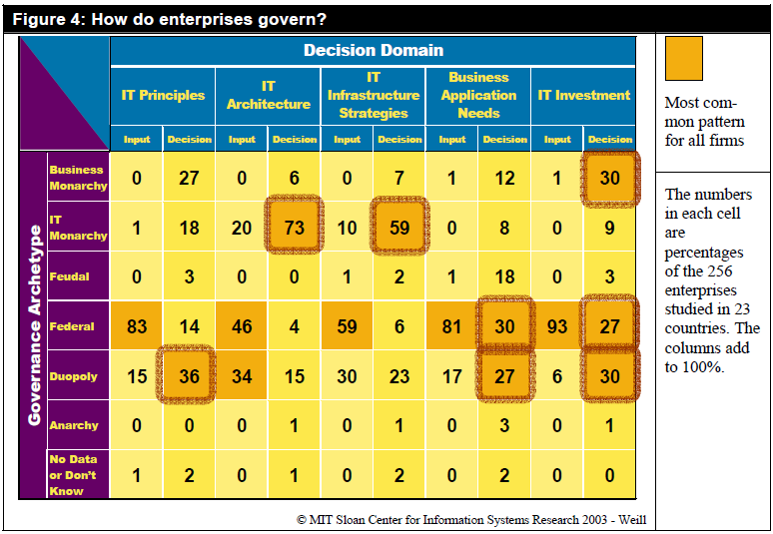
How Enterprises Actually Govern - Survey
© MIT Sloan CISR
Notes:
Figure 2-7 Which Governance Style for each Key IT Decision
What are the components of top level IT governance?
A matrix can be used to depict governance arrangements by listing the six governance styles on the vertical and map them to the five IT domains on the horizontal.
The MIT Sloan CIST and Gartner EXP study identified how 256 enterprises made major decisions - who had decision rights and who had input about each of the five IT domains.
Evidence to date shows that there are typical IT governance input and decision rights patterns. The federal style dominates, with IT making infrastructure and architecture decisions
Source: MIT Sloan CISR

Slide 100
Top 3 Governance Performers from Survey
Governance Decisions
Domain
Style
IT Principles
IT Architecture
IT Infra- structure
Strategies
Business
Application Needs
IT Investment
Business
Monarchy
3
3
3
2
3
IT
Monarchy
1
1
2
2
Feudal
Governance Archetype
Federal
1
3
Duopoly
1
1
2
2
Anarchy
Don’t Know
© MIT Sloan CISR
Notes:
Figure 2-7 Which Governance Style for each Key IT Decision
What are the components of top level IT governance?
This chart shows the types of governance archetypes and decisions that are used together by the top three most successful firms in the survey.
The MIT Sloan CIST and Gartner EXP study identified how 250 enterprises made major decisions - who had decision rights and who had input about each of the five IT domains.
Evidence to date shows that there are typical IT governance input and decision rights patterns. The federal style dominates, with IT making infrastructure and architecture decisions
Source: MIT Sloan CISR

Slide 101
Next Module 7
Secured a computer lab:
We will meet in CDM 819 lab
Virtual Collaboration Technologies
Social Media

Slide 102

Questions

